Slide 1

Show me the money
DSC 680 Applied Data Science
Project 2 Michael Loos
Notes:
.

Slide 2
Agenda
Background
Proposal
Data
Methods
Analysis
Conclusion

Slide 3
Background
Difficult to know salary when applying to a job
Often only receive wide ranges
Can be a waste of time for candidates and organizations
Can we predict the salary?

Slide 4
Proposal
Create a linear regression model to predict salaries for a position
Use role description and applicant characteristics
The model would benefit job seekers and potential employers

Slide 5
Data
Source: 2019 Kaggle survey within Data Science industry
Email lists, forums, and social media
19,000 total responses
Reduced to ~2000
34 questions
What is your current yearly compensation)?
What is your age?
What is your gender? - Selected Choice
In which country do you currently reside?
What is the highest level of formal education that you have attained or plan to attain within the next 2 years?
Select the title most similar to your current role (or most recent title if retired): - Selected Choice
What is the size of the company where you are employed?
What programming languages do you use on a regular basis? (Select all that apply)
Which of the following ML algorithms do you use on a regular basis? (Select all that apply)
Mostly categorical data
Data cleaning

Slide 6
Methods
Python was used to view and clean data
US only
Salary restrictions
Mean salary variable
R used for EDA and modeling
Multiple linear regression model
Age
Gender
Education
Role title
Programming language
Company size

Slide 7
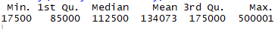
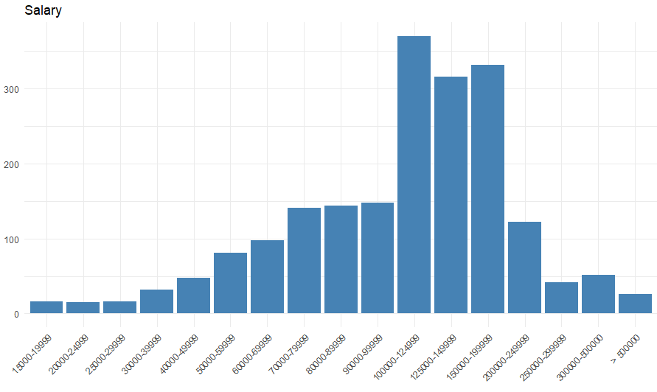
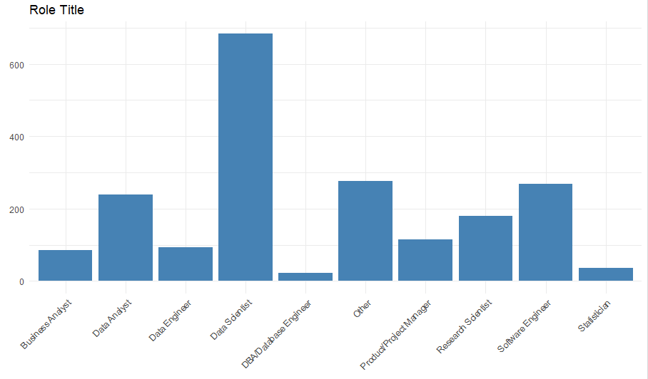
Exploratory Data Analysis
Summary statistics
Salary
Salary by variables (role title, gender, education)
Visualizations
Variable distributions
Salary by variables
Salary

Slide 8
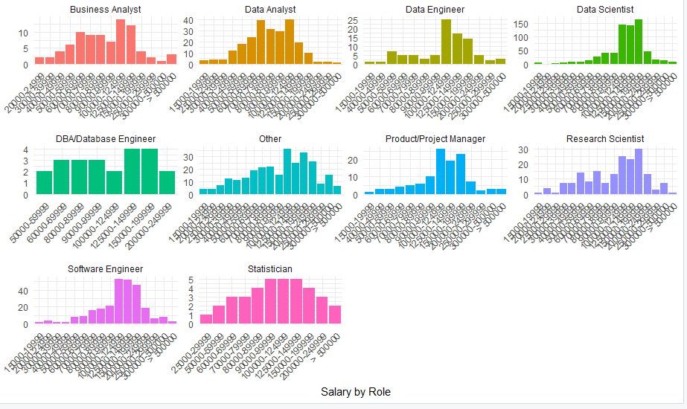
Exploratory Data Analysis
Salary by Role Title

Slide 9
Analysis
Training model
First model used age, gender, education, role, company size, and programming language
F-statistic: 7.46
R-squared: 0.1819
Intercept: $80,773
Final model used age, gender, role, and company size
F-statistic: 10.88
R-squared: 0.1384
Intercept: $65,442
Data Scientists increases pay more than any other role
Income increases with age
Being male increases income

Slide 10
Conclusion
Model results were disappointing
Uses
Personal use
Consultation
Job posting sites
Ethical issues
Disparate impact
Age
Gender

